Slide 1
Classification of Electric Towers and Detection of Lines
Rahul Ramesh Kumar (rrk310)

Slide 2
Motivation
Currently manual inspection of Electric Towers is very costly .
High Risk for linemen.
Aim is to automate inspection and reduce costs.

Slide 3
Problem Statement
Identify types of Electric Towers and Classify them.
Extract Line Segments that form the Electric Tower.
Re construct Line segments to form tower image.
Feed back image into the IBM Visual Recognition Classifier.

Slide 4
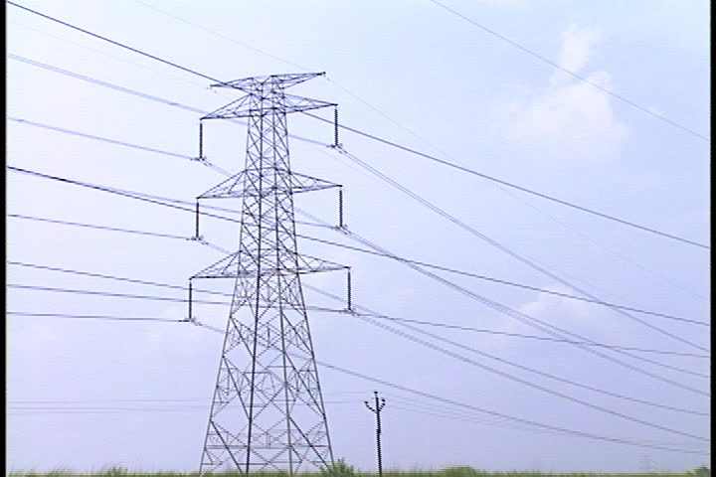
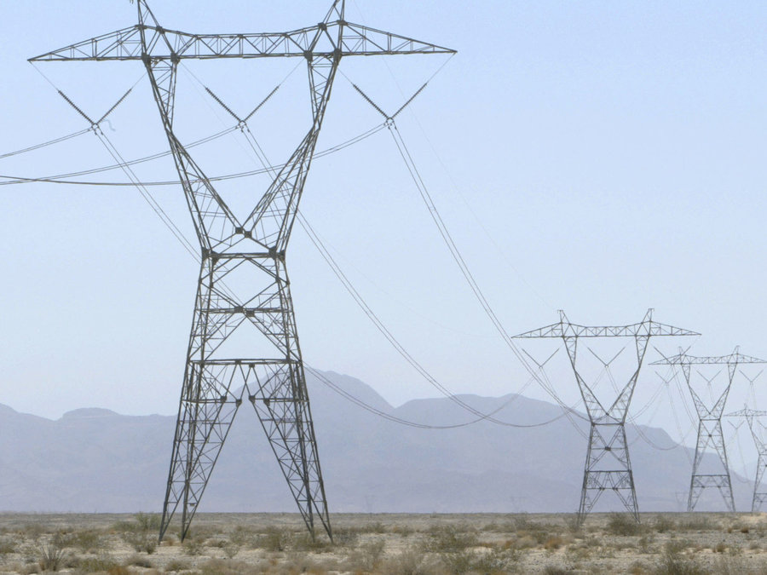
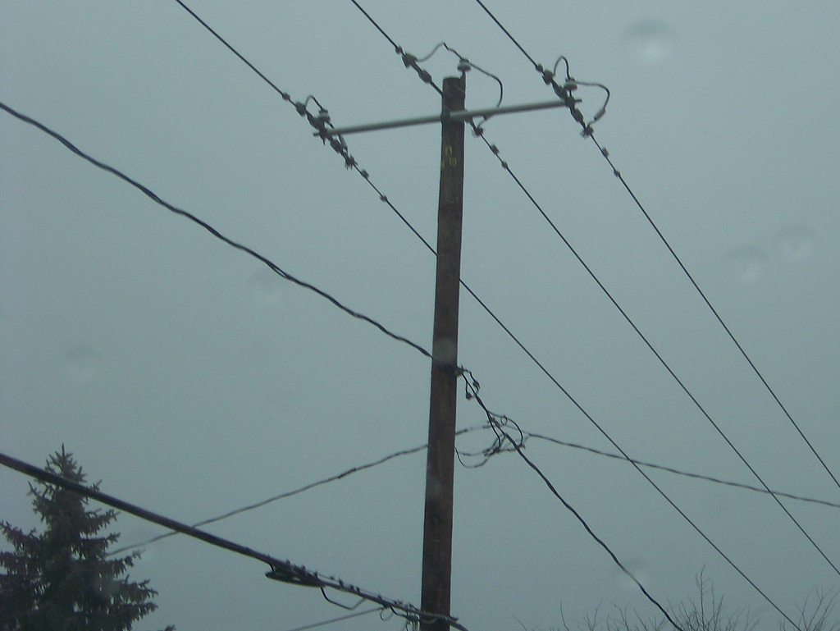
Types of Towers
Type 1
Type 2
Type 4

Slide 5
1. Classify
IBM Visual recognition as a classifier
Three classes Type 1, Type 2, Type 4
Training set of 25 positive/negative images each and 6 images for Test.
Obtained Confidence Interval
TPR = 93.59 to 95.28
FPR = 3.91 to 5.60

Slide 6
2. Extraction of Line Segments
Using Line Segment Detector in C [1].
First image is converted to PGM file .
The classified image is sent to the Detector and all line segments that Form the image is output.
Notes:
1. http://www.ipol.im/pub/art/2012/gjmr-lsd/ - Used an existing detector written in C

Slide 7
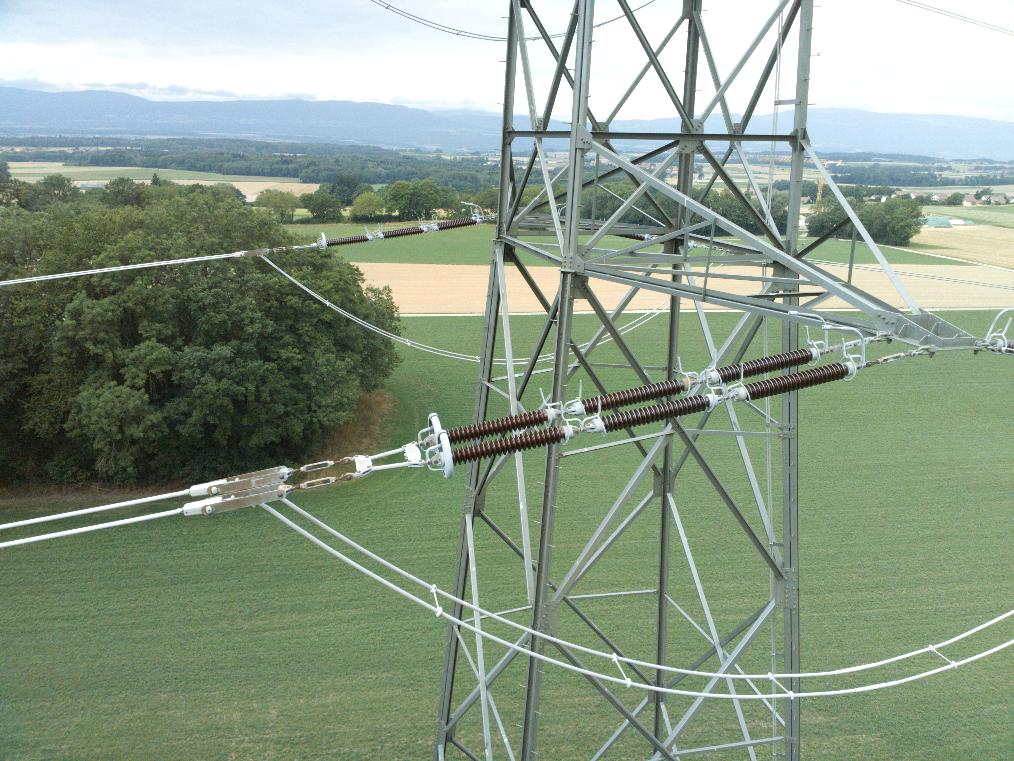
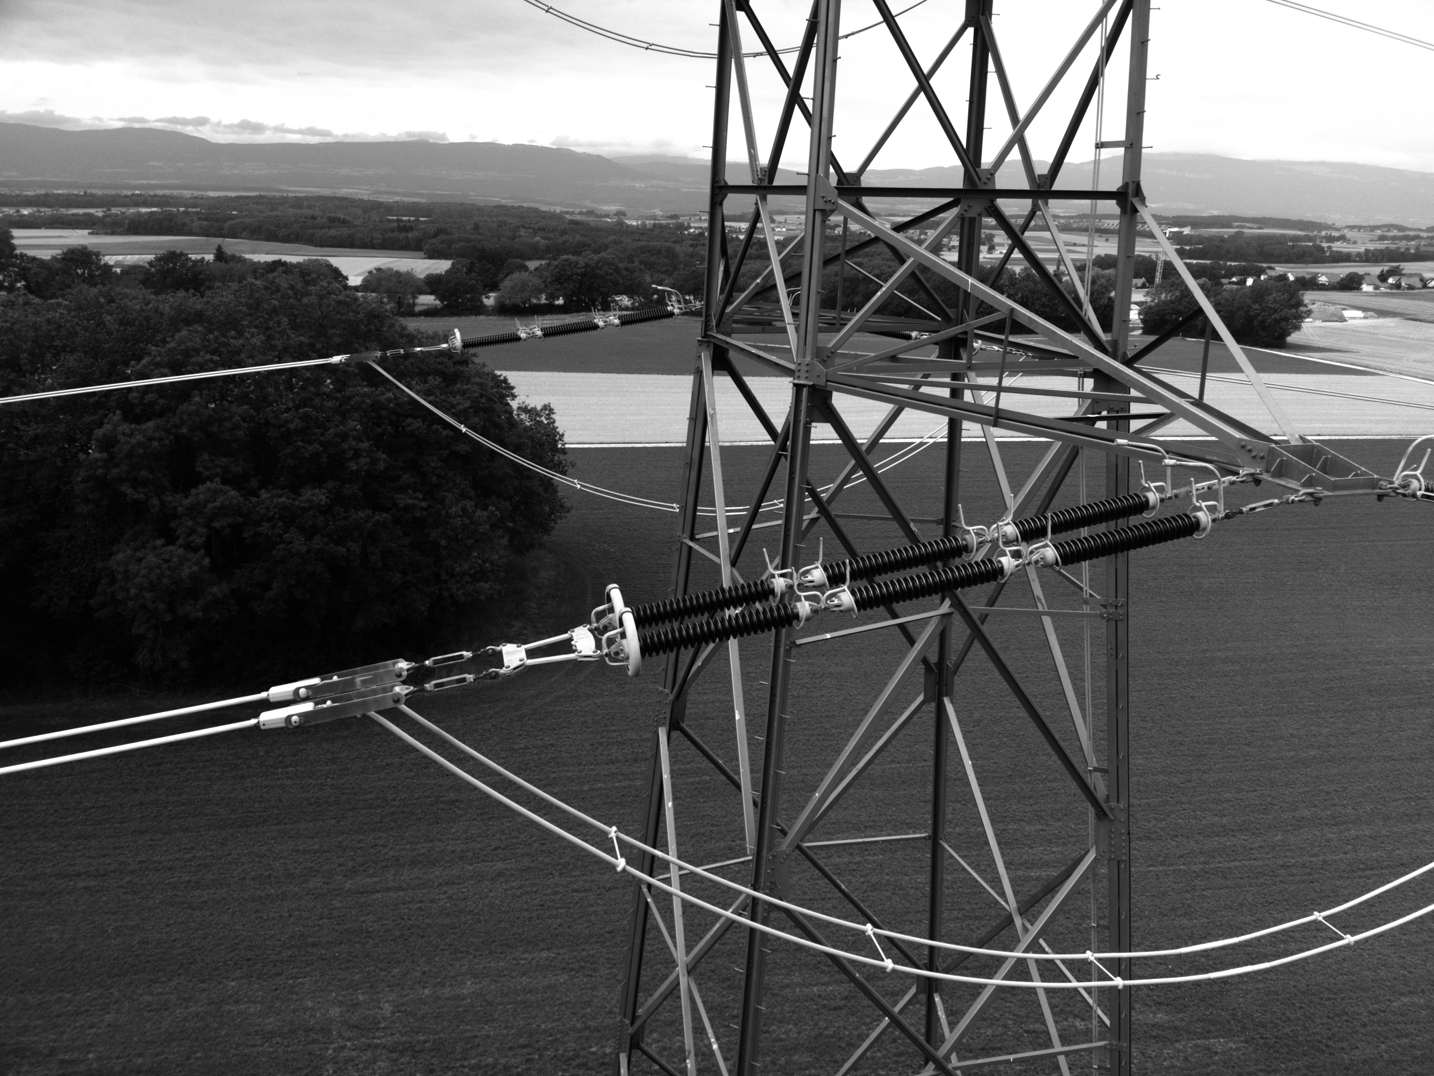
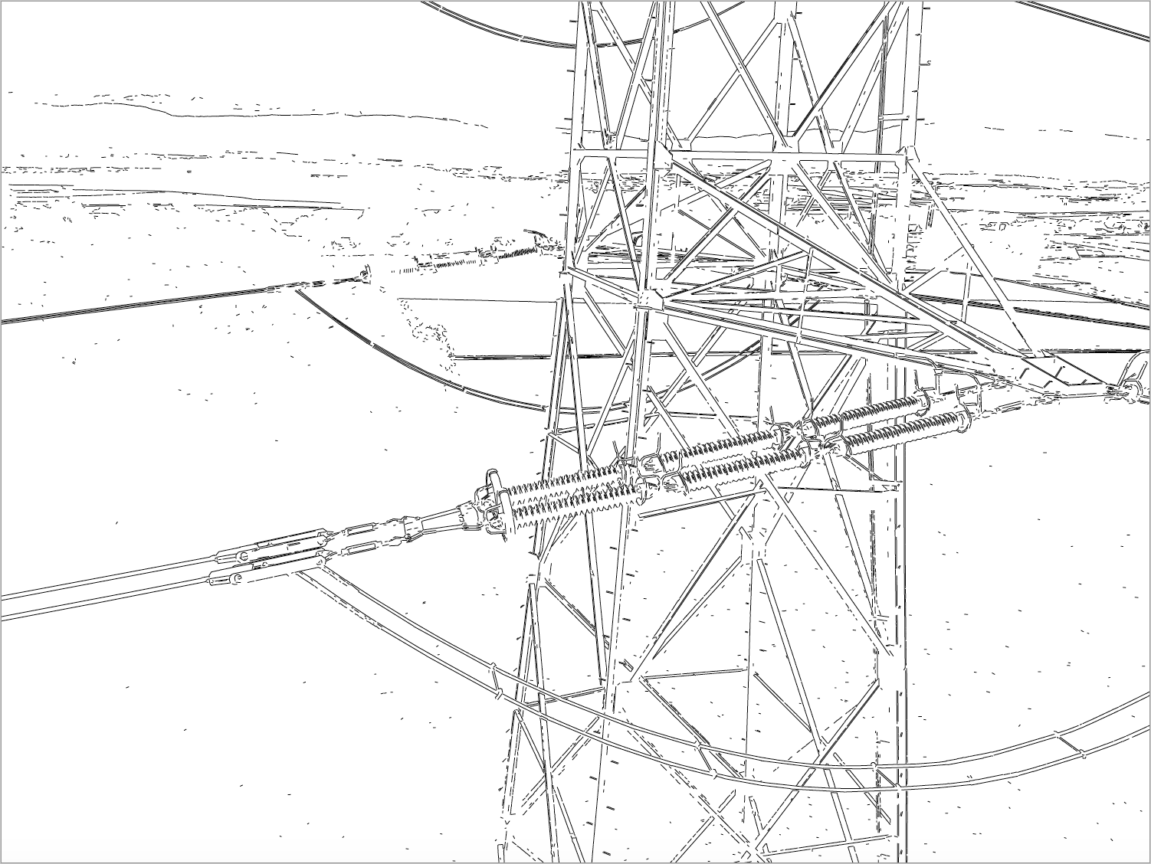
Image Produced after extracting Line Segments

Slide 9
3. Finding Parallel Lines
First finding Slope of Each Line and its Length.
Bin the slopes of each line segment with a variation of 5 degrees.

Slide 10
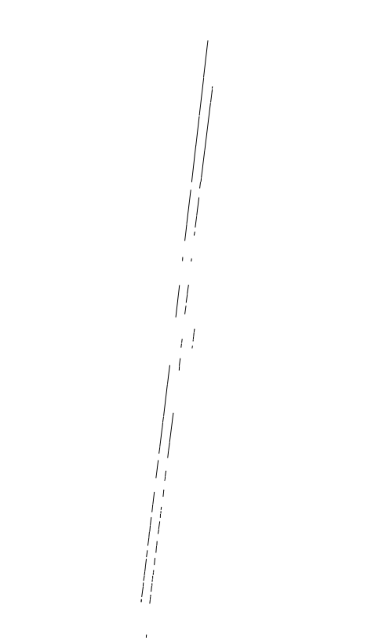
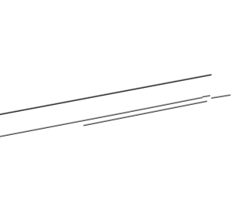
Output

Slide 11
4. Finding Overlapping Distance
Find overlap distance between each line (n * n)
By projecting the Line segment to either X or Y axis.
Account for various cases of overlap between any two line segment.
Check also slope to avoid lines of different slopes to have overlap.

Slide 12
5. Apply Threshold to get Single Lines
We have three thresholds
Slope <= 5 degree variation
Perpendicular distance <= 5 pixels
Overlap distance <= 50 pixels

Slide 13
6. Merge all of the Lines near Tower
Sort all lines based on start_X or start_Y based on orientation.
Create a new segment if its possible to merge two segments given a threshold perpendicular distance, overlap distance and angle
New segments must have their overlap distance recalculated.
Run for all line segments in the tower.

Slide 14
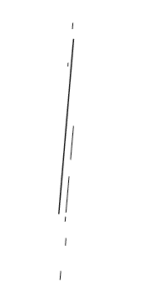
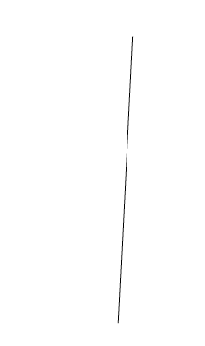
Output: Merge Line segments
Merged line
Original

Slide 15
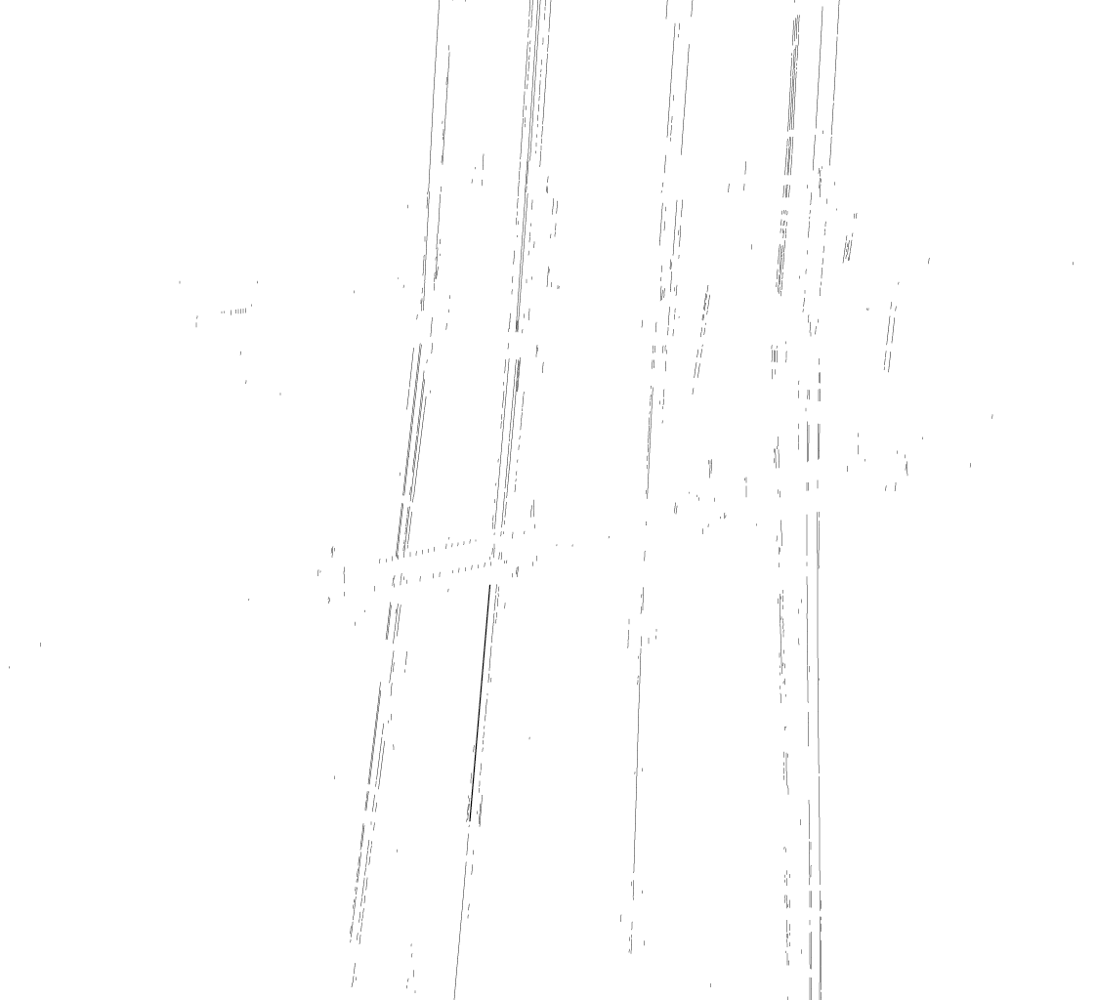
Isolated tower after threshold application

Slide 16
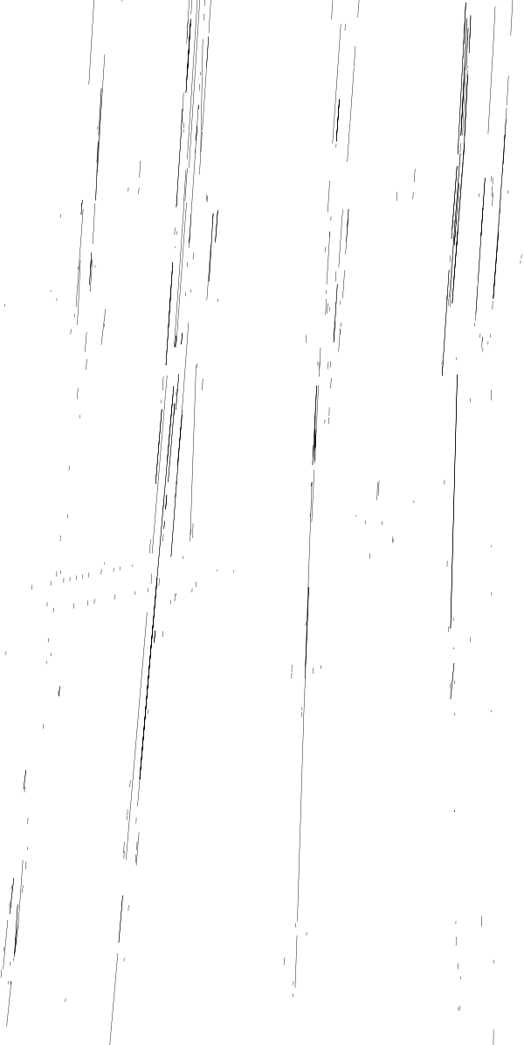
Output: Merge entire tower

Slide 17
Feed Back into IBM Watson
The produced image can be fed back to IBM Watson to train it .
By only extracting the local features of the tower and providing it to the classifier, False positives can be reduced.

Slide 18
Performance and Memory
The Line segment extraction takes around 7 – 10 seconds to complete .
n is the number of line segments in the processed image.
Current time complexity is O(n*n)
Extra memory used to Hold overlap distance, perpendicular distance
And slopes – O(n*n)

Slide 19
Improvements
The merge algorithm does not currently consider lines parallel to x axis and so the tower support structures are not seen. Handling them also helps to extract more accurate features.
The algorithm assumes image is oriented well and for rotated images a pre rotation must be performed. An automatic way of rotating images can be done using Automated feature matching .
Improve algorithm for different types of Towers .

Slide 20
Acknowledgements
I would like to thank Dr. Sharath Pankanti and Dr. Nalini K. Ratha for providing feed back during the course of the project and also introducing me to various topics in Computer Vision.

Slide 21
References
http://visual-recognition-demo.mybluemix.net
image-net.org
A Supervised Approach to Electric Tower Detection and Classification for power Line Inspection
LSD: a Line Segment Detector 2012

Slide 22
Thank You

